Slide 1
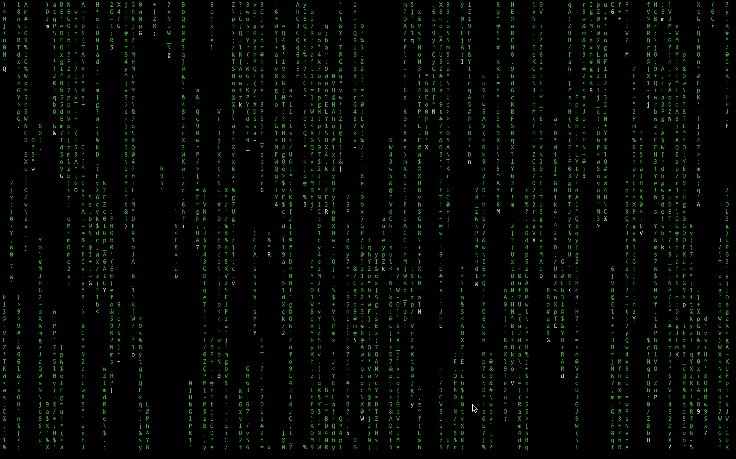
Python for Analytics
Unlocking the Secrets Hidden in Your Data
Deepak Mishra

Slide 2
Scope of this Learning Session
Data Science Technology Stack
Why use Python
Overview of Python Libraries for Data Science
Using Python on JupyterNotebook
Connect to Server to get data
Python Programming : Elementary Operations

Slide 3
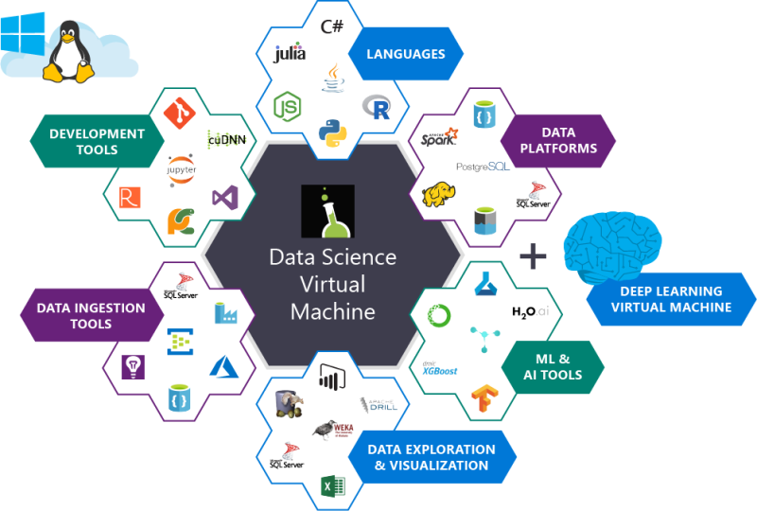
Data Science Technology Stack

Slide 4
Why use Python…
Since its first appearance in 1991 by Guido van Rossum in the Netherlands, Python has become one of the most popular interpreted programming languages
Python is distinguished by its large and active scientific computing community.
Libraries to interface other languages (C/C++/Fortran) ,with the same performances ! ! Critical part of codes are written in a lower level language
Python’s improved support for libraries (such as pandas and scikit-learn) has made it a popular choice for data analysis tasks.
Python is a suitable language not only for doing research and prototyping but also for building the production systems
It is free and open-source and runs on Windows, Mac, Linux distros
Fewer lines of code required – faster to write

Slide 5
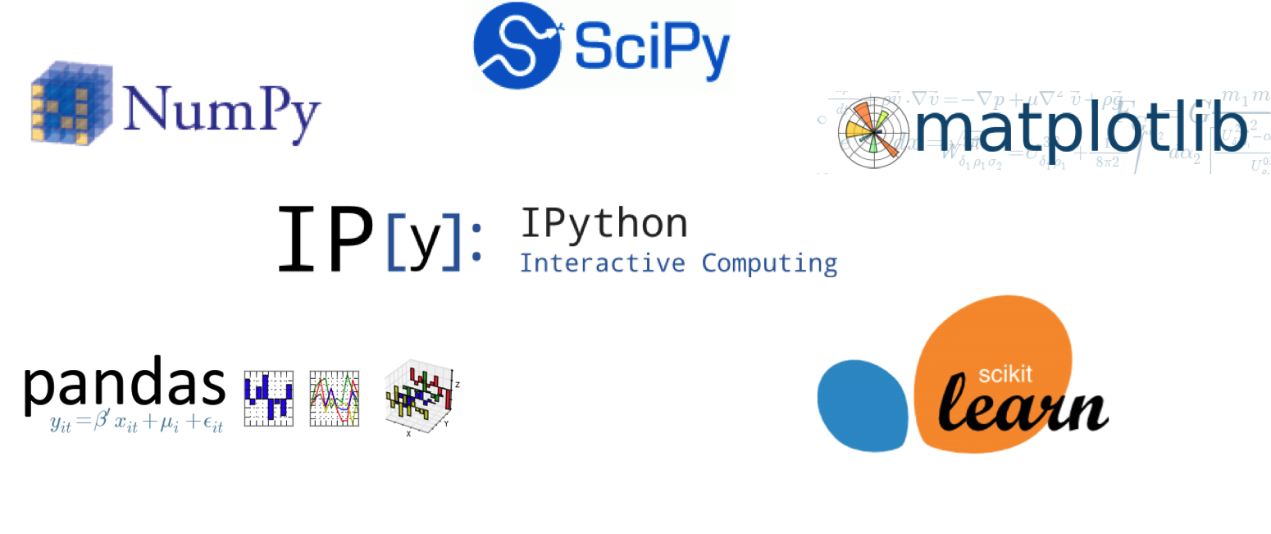
Overview of Python Libraries for Data Science
And Many More……… we will explore them in subsequent sessions

Slide 6
Python Toolkit for Analytics
Foundational Tools
NumPy: Enables numerical computing in Python. Offers efficient multidimensional arrays and linear algebra operations
Pandas: Provides high-performance data structures like DataFrames and Series, enabling easy data cleaning, transformation, and aggregation
Data Visualization
Matplotlib: The illustrator, creating static, publication-quality visualizations for in-depth analysis.
Plotly: The animator, bringing data to life with interactive charts and graphs for user exploration
Beyond the Basics
Scikit-learn/h2o: A toolkit, packed with machine learning algorithms to uncover patterns and make predictions.
TensorFlow/PyTorch/Keras: Popular deep learning frameworks, extending Python's capabilities to handle complex data and tasks like image recognition and natural language processing.
BeautifulSoup: Imagine this library as your web page decoder, helping you parse the structure of websites and extract specific information

Slide 7
Python Programming : Elementary Operations
Edit presentation title on Slide Master using Insert > Header & Footer

Slide 8
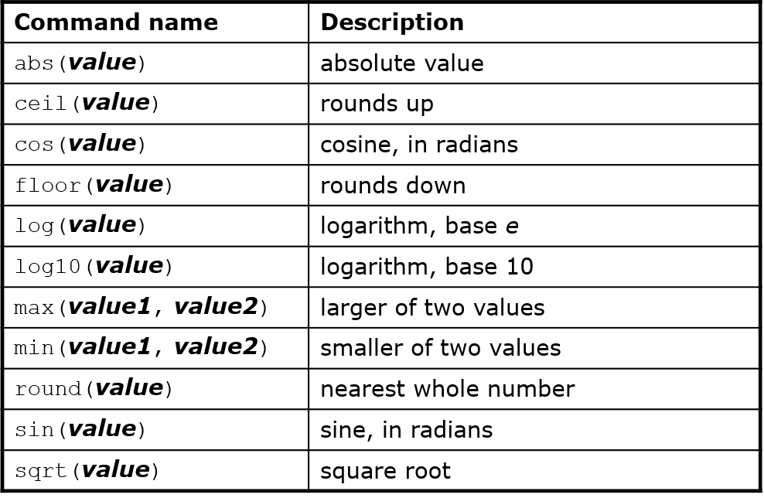
Mathematical functions
import math
Arithmetic operators we will use:
+ - * / addition, subtraction/negation, multiplication, division
% modulus, a.k.a. remainder
** exponentiation
Precedence: Order in which operations are computed.
* / % ** have a higher precedence than + - 1 + 3 * 4 is 13
Parentheses can be used to force a certain order of evaluation. (1 + 3) * 4 is 16
7 / 3 * 1.2 + 3 / 2
2 * 1.2 + 3 / 2
2.4 + 3 / 2
2.4 + 1
3.4

Slide 9
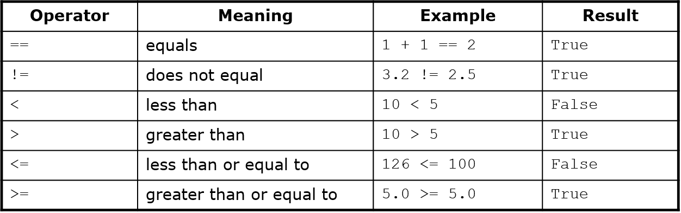
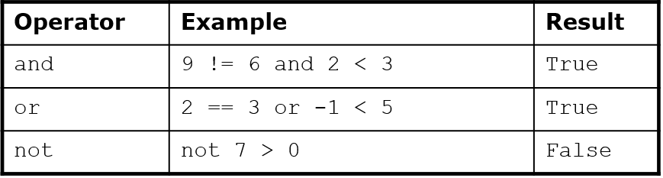
Relational and Logical Operators

Slide 10
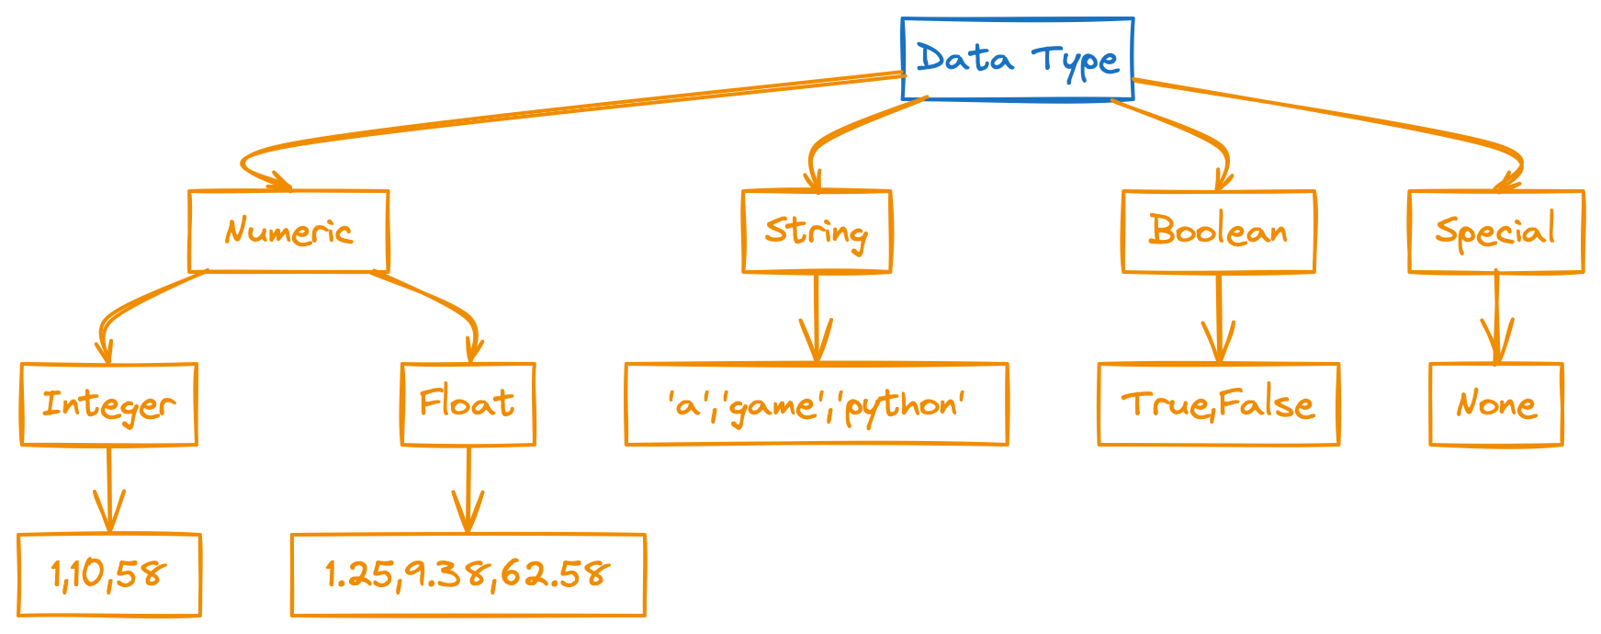
Key Data Types in Python

Slide 11
Strings
"hello"+"world" "helloworld" # concatenation
"hello"*3 "hellohellohello" # repetition
"hello"[0] "h" # indexing
"hello"[-1] "o" # (from end)
"hello"[1:4] "ell" # slicing
len("hello") 5 # size
"hello" < "jello" 1 # comparison
"e" in "hello" 1 # search
"escapes: \n etc, \033 etc, \if etc"
'single quotes' """triple quotes""" r"raw strings"

Slide 12
Key Data Types in Python
Python offers a variety of data types to represent different kinds of information:
1. Numeric Types:
int (integer): Represents whole numbers (positive, negative, or zero).
Example: age = 25
float (floating-point): Represents numbers with decimal points.
Example: pi = 3.14159
complex: Represents complex numbers with a real and imaginary part.
Example: z = 3 + 2j
2. Textual Type:
str (string): Represents sequences of characters, often used for text data.
Example: name = "Alice"
3. Boolean Type:
bool: Represents logical values, either True or False.
Example: is_raining = True
4. Collection Types:
list: An ordered, changeable collection of items, enclosed in square brackets [].
Example: fruits = ["apple", "banana", "orange"]
tuple: An ordered, immutable collection of items, enclosed in parentheses ().
Example: coordinates = (10, 20)
set: An unordered collection of unique items, enclosed in curly braces {}.
Example: unique_numbers = {1, 2, 3, 2}
dict (dictionary): An unordered collection of key-value pairs, enclosed in curly braces {}.
Example: customer = {"name": "John", "age": 30}
5. Special Types:
None: Represents the absence of a value.
Example: x = None

Slide 13
Lists
Flexible arrays
a = [99, "bottles of beer", ["on", "the", "wall"]]
Same operators as for strings
a+b, a*3, a[0], a[-1], a[1:], len(a)
Item and slice assignment
a[0] = 98
a[1:2] = ["bottles", "of", "beer"]
-> [98, "bottles", "of", "beer", ["on", "the", "wall"]]
del a[-1] # -> [98, "bottles", "of", "beer"]
>>> a = range(5) # [0,1,2,3,4]
>>> a.append(5) # [0,1,2,3,4,5]
>>> a.pop() # [0,1,2,3,4]
5
>>> a.insert(0, 42) # [42,0,1,2,3,4]
>>> a.pop(0) # [0,1,2,3,4]
5.5
>>> a.reverse() # [4,3,2,1,0]
>>> a.sort() # [0,1,2,3,4]
Check Out List Comprehension

Slide 14
Dictionaries
Keys must be immutable:
numbers, strings, tuples of immutables
these cannot be changed after creation
reason is hashing (fast lookup technique)
not lists or other dictionaries
these types of objects can be changed "in place"
no restrictions on values
Keys will be listed in arbitrary order
again, because of hashing
Hash tables, "associative arrays"
d = ["duck": "eend", "water": "water"]
Lookup:
d["duck"] -> "eend"
d["back"] # raises KeyError exception
Delete, insert, overwrite:
del d["water"] # ["duck": "eend", "back": "rug"]
d["back"] = "rug" # ["duck": "eend", "back": "rug"]
d["duck"] = "duik" # ["duck": "duik", "back": "rug"]
Keys, values, items:
d.keys() -> ["duck", "back"]
d.values() -> ["duik", "rug"]
d.items() -> [("duck","duik"), ("back","rug")]
Presence check:
d.has_key("duck") -> 1; d.has_key("spam") -> 0
Values of any type; keys almost any
["name":"Guido", "age":43, ("hello","world"):1, 42:"yes", "flag": ["red","white","blue"]]

Slide 15
Object Referencing
a = [1, 2, 3]
a
1
2
3
Assignment manipulates references
x = y does not make a copy of y
x = y makes x reference the object y references
Very useful; but beware!
Example:
>>> a = [1, 2, 3]
>>> b = a
>>> a.append(4)
>>> print b
[1, 2, 3, 4]
a
b = a
1
2
3
b
a
a.append(4)
1
2
3
4
b
new int object created
by add operator (1+1)
a = 1
a
1
a
a
2
b = a
1
a = a+1
old reference deleted
by assignment (a=...)
b
b
1

Slide 16
APPENDIX
Edit presentation title on Slide Master using Insert > Header & Footer

Slide 17
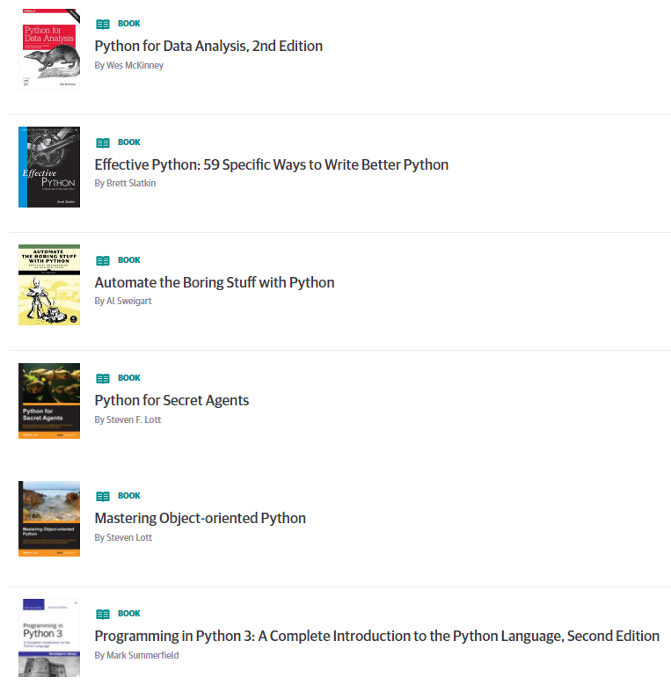
Learning Resources
List of Books for Reference
https://learning.oreilly.com/playlists/9bddcfcd-d39d-43f5-8b71-18e8632d054b
Courseera.org
A gallery of interesting Jupyter Notebooks
https://github.com/jupyter/jupyter/wiki/A-gallery-of-interesting-Jupyter-Notebooks
https://www.dataquest.io/blog/jupyter-notebook-tips-tricks-shortcuts/

